Slide 1
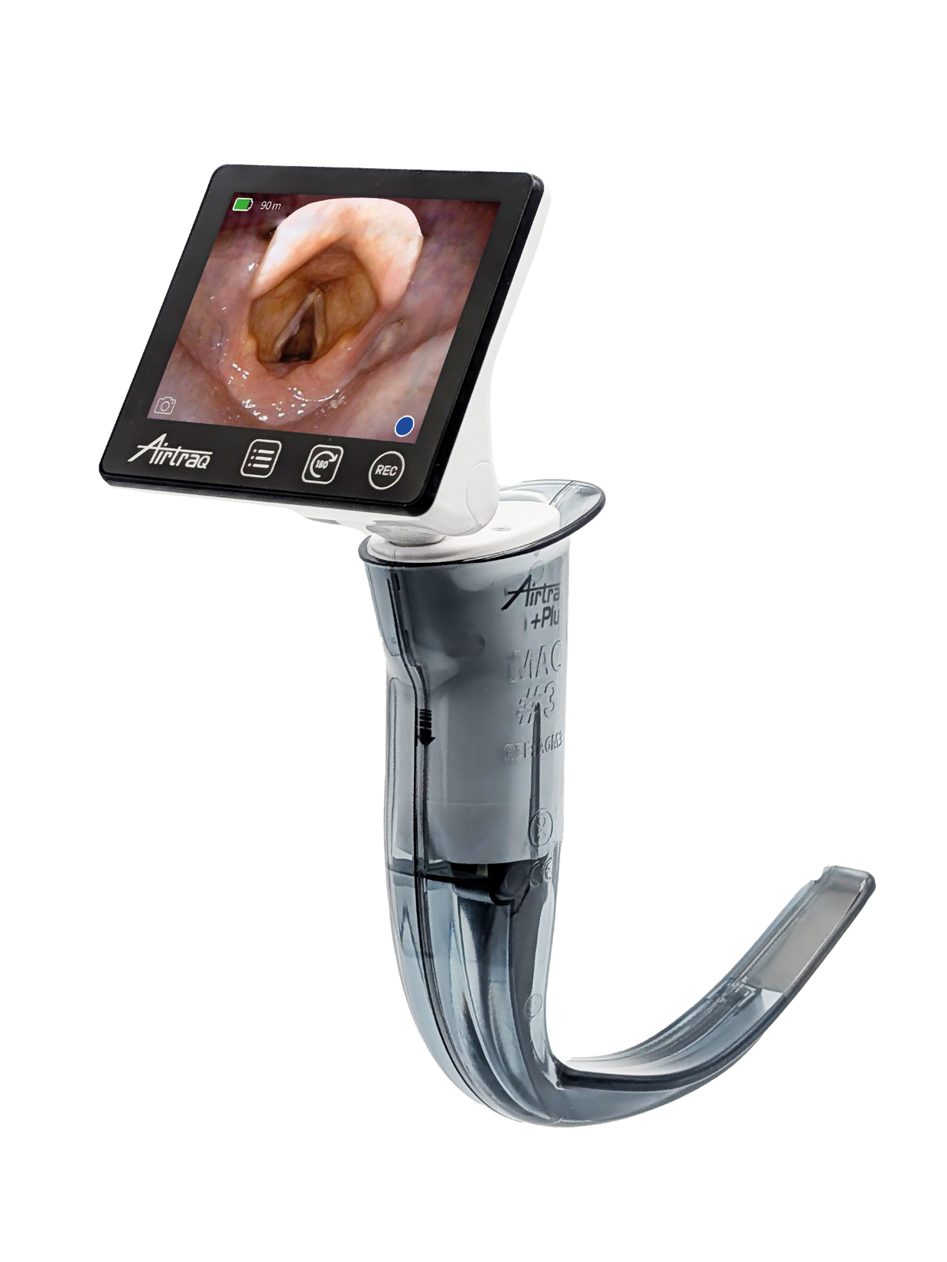

Quick Start Guide
Rev 0.0

Slide 2

Full Instructions For Use at:

Slide 3
Contents (1)
Airtraq Plus Elements
Package Contents
Blade Types and Sizes
Apps
Switches & Connectors
Battery Charge
Initial Set Up. Warranty & SW update
Protection against accidental impacts
Blade Assembly. Automatic Power On
Blade Extraction and disposal

Slide 4
Contents (2)
Turn On/Off
Screen Flip & Swivel
Image Rotation
Wi-Fi Connection Overview
Wi-Fi Connection to Max View
WiFi Connection to Tablets/Phones
HDMI Cable Connection.
VL+FOB
Video recording & Snapshots
Auto-Record

Slide 5
Contents (3)
Gallery and Playback
Download & Delete videos
View and add notes to video files
Cleaning and Low Level Disinfection
Troubleshooting
User Assistance
Important Safety Instructions

Slide 6
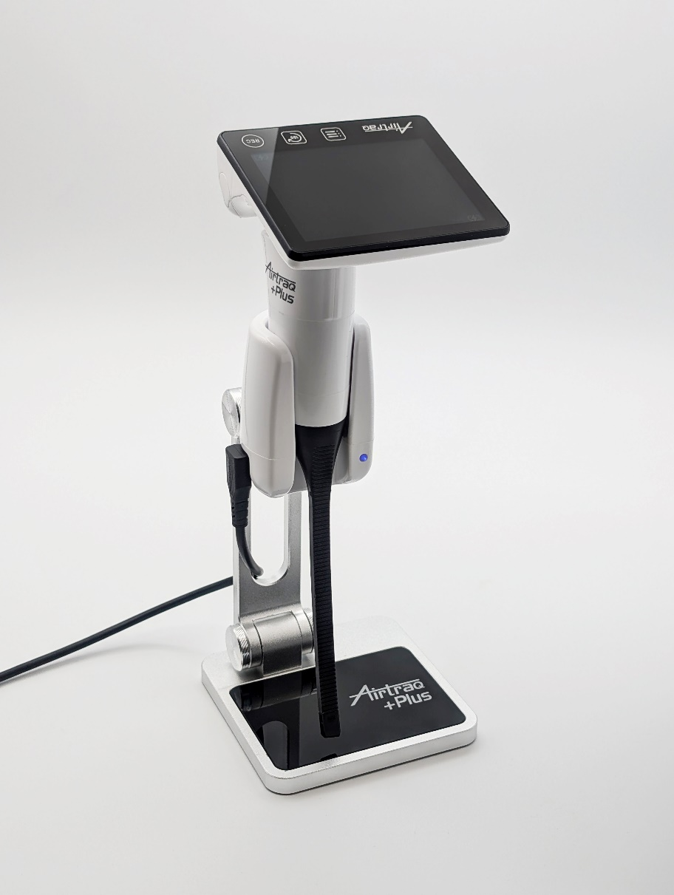
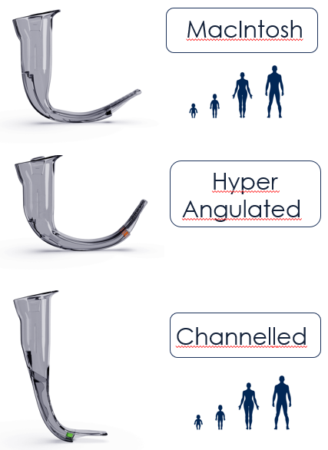
1. Airtraq Plus Elements.
Video Unit & Charging Dock
Single Use ECO Blades

Slide 7
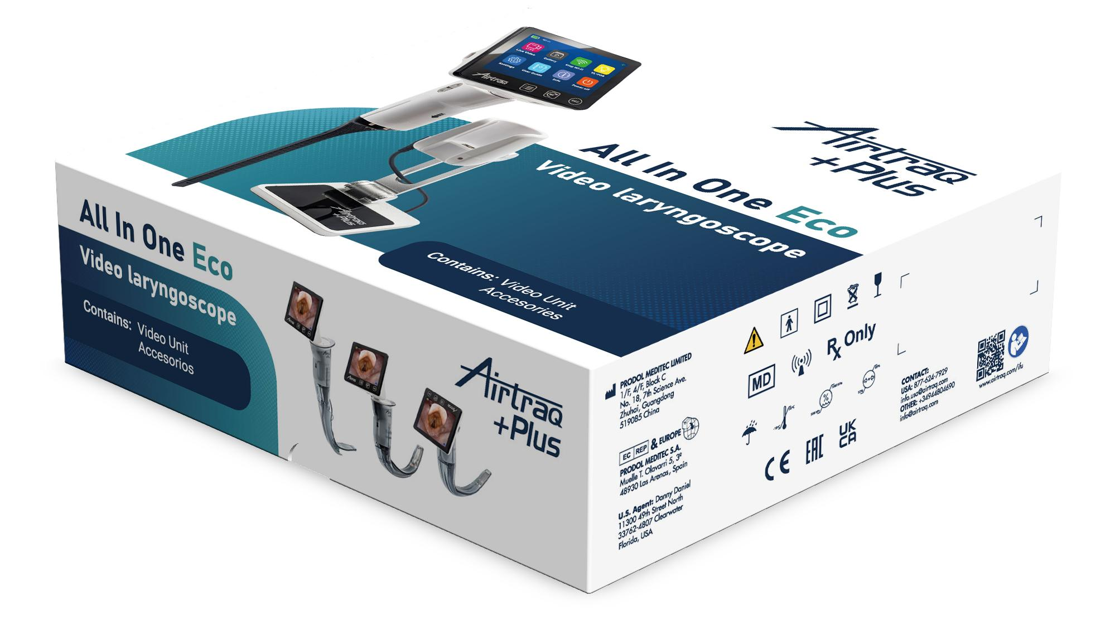
2. Package Contents.
  USB-C to HDMI video cable (Ref: A680)
  Video Unit with protective case
  AC/DC Charger
  & Plugs
  USB-A to USB-C
  90º charging cable
  ( Ref: A692)

Slide 8
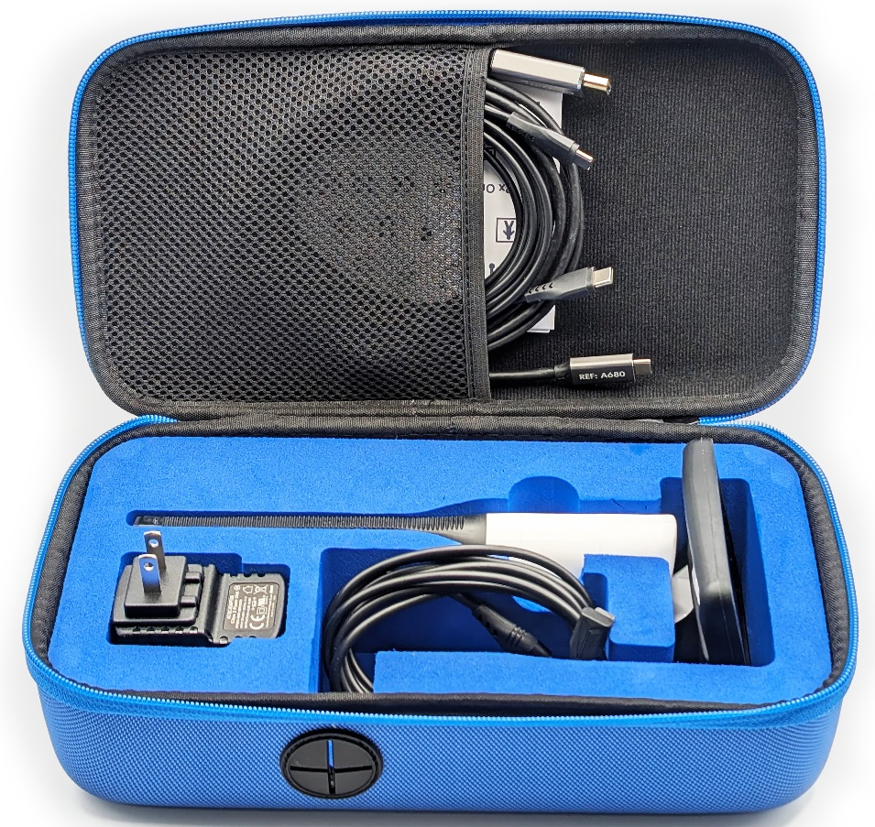
2. Package Contents.
A. Nylon Storage Case
  USB-C to HDMI video cable (Ref: A680)
  USB-C to HDMI video cable (Ref: A680)
  USB-C to USB-C
  data cable
  (Ref: A681)
  AC/DC Charger
  & Plugs
  ( Ref: A691)
  Video Unit with protective case
  Video Unit with protective case
  USB-A to USB-C 90º
  charging cable ( Ref: A692)

Slide 9
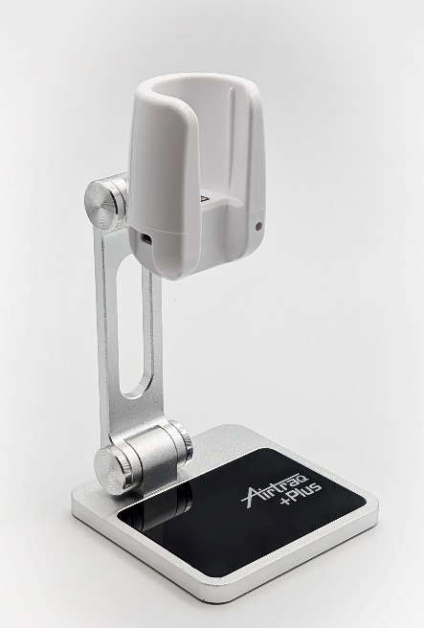
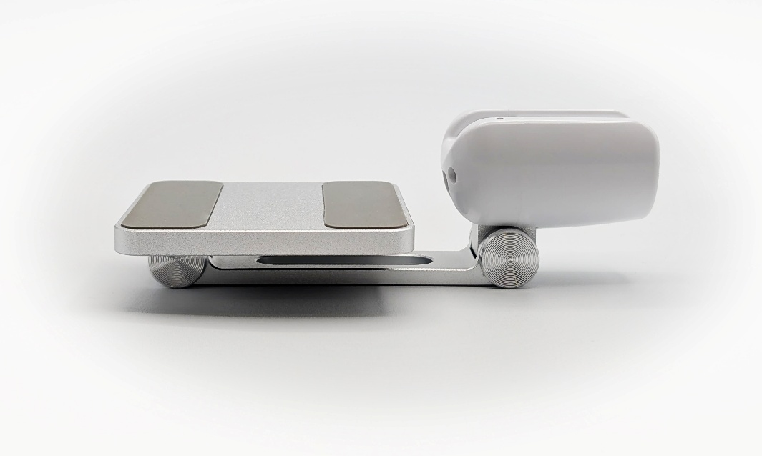
2. Package Contents.
B. Charging Dock

Slide 10

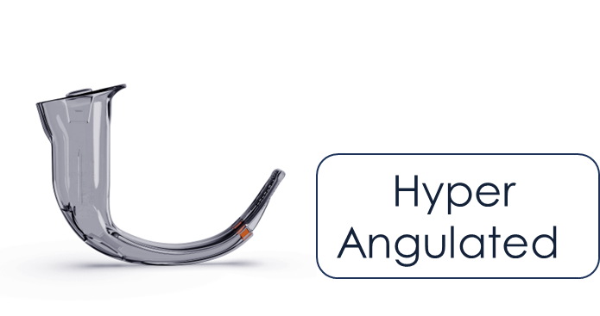
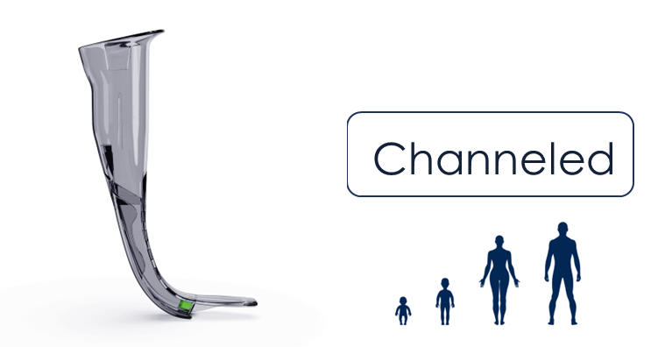
3. Single Use ECO Blades Types and Sizes
Mac #4 Ref : A6M4
Mac #3 Ref : A6M3
Mac #2 Ref : A6M2
Mac #1 Ref : A6M1
H Blade Ref : A6HA
Channelled Regular Ref : A6C3
Channelled Small Ref : A6C2
Channelled Pediatric Ref : A6C1
Channelled Infant Ref : A6C0

Slide 11
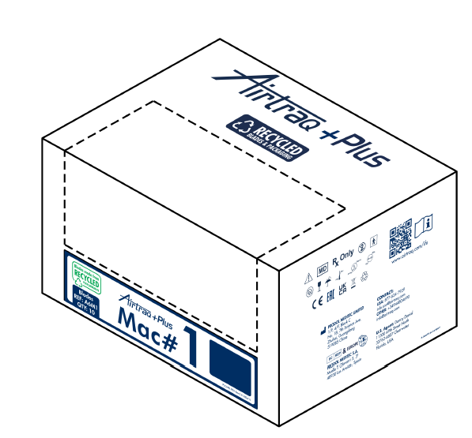

3. Single Use ECO Blades Packaging
Blades are individually blistered.
Blistered blades are packaged in 10 pcs. boxes, designed to facilitate blade extraction and box presence inside OR.
Boxes of 10 pcs. are packaged in 50 pcs. shipping cartons.
Blisters and Boxes are made from recycled materials.

Slide 12




4. Apps
1. ‘Airtraq Cam’ App for PC (Windows /Mac) :
  For initial set up, SW update, download recorded videos and WiFi live video.
  Free download from:
  www.Airtraq.com/downloads/
2. ‘Airtraq Cam’ App for:
iOS (Apple) and Android:
  Install on each mobile device to connect Wi-Fi to Airtraq Plus.

Slide 13
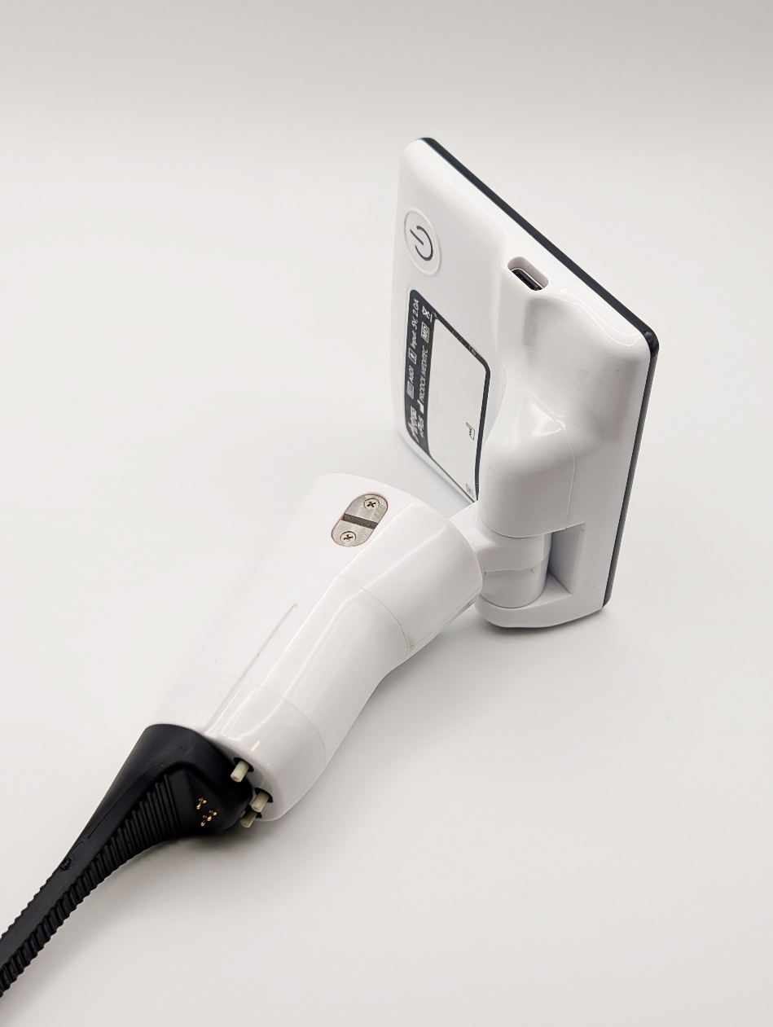
5. Switches & Connectors.
Video Unit
Power On switch: Press 2 seconds to start. It does not power off the device.
D
A
Automatic blade detection switches: They are activated when blades are assembled.
E
Battery charge pins.
USB-C female port :To connect to PC or to battery charger or to A-300 Max View Display.
B
C
Slot for blade lock.

Slide 14

5. Switches & Connectors.
Charging dock
USB-C female port :To connect to AC/DC charger.
F
Battery charge pins.
G
E
Charge light indicator.

Slide 15
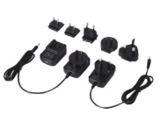
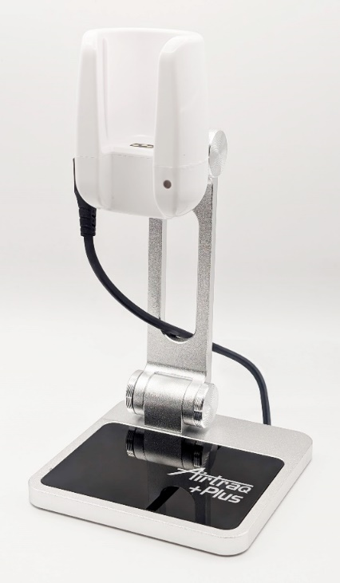
6. Battery Charge.
Charging Dock Preparation
Charge always at least 2 m. away from the patient.
Use provided AC/DC Charger and USB-A to 90º elbow USB-C cable A692.
Select adequate plug for AC/DC charger and assemble it. Discard rest of plugs.
Unfold charging dock.
Connect cable A692 to charging dock and mains supply
AC/DC Charger can also be directly connected to Video Unit USB-C port.

Slide 16

6. Battery Charge.
Insert Video Unit into charging dock cradle.
Charging Dock provides an intermittent blue light while charging and a continuous blue light when device is fully charged.
Full battery Operating Time: Aprox. 150 min.
Full charging cycle : Aprox. 180 min.
Video Unit will not power on unless remaining operating time is over 5 min.

Slide 17
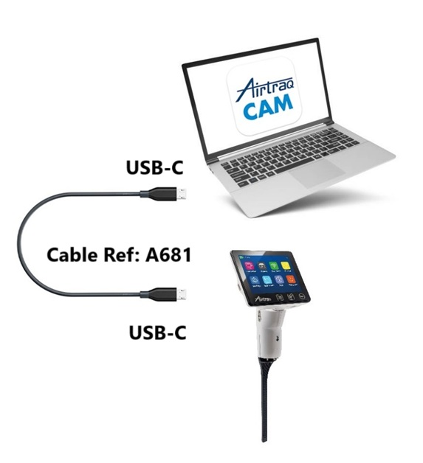
7. Initial
Set Up.
Connection to PC
Download & Install ‘Airtraq Cam’ app for PC/Mac from www.Airtraq.com/downloads/
Connect Airtraq Plus to a PC (Windows or Mac) connected to Internet. Use USB-C to USB-C cable provided (A681)
Open ‘Airtraq Cam’ App in PC.
Allow automatic date/time Synchronization.

Slide 18
7. Initial
Set Up. Warranty & SW Update
  Upon first connection, activate warranty
  Update Software, if prompted.

Slide 19

7. Initial
Set Up. Options
  Go to “Settings”
  Select Language
  Set Device Id
  Create / Change Wi-Fi Password
  Set Auto-Recording On/Off
  Set maximum video time for auto recording.
  Save options by clicking on

Slide 20
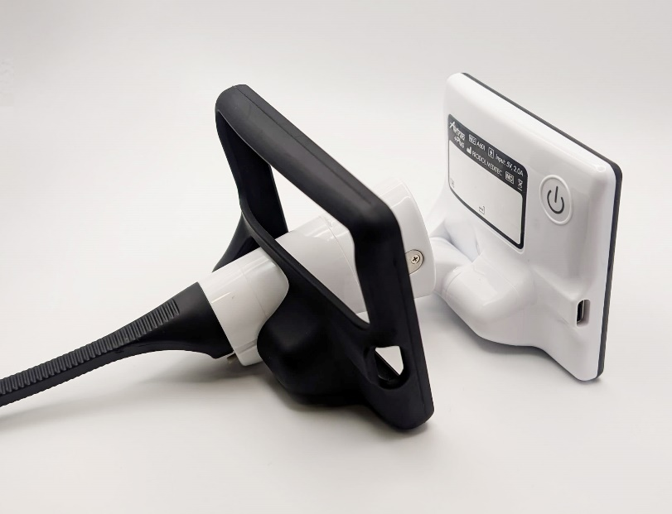
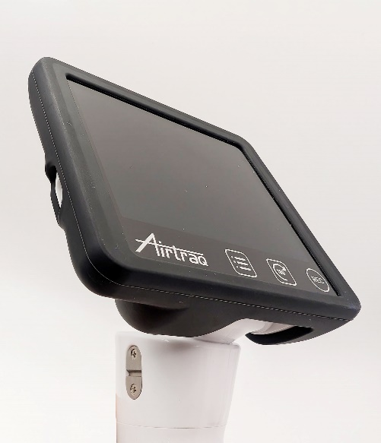
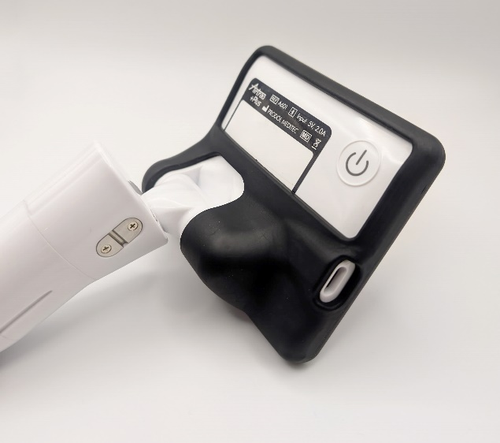
8. Protection against accidental impacts
Slide Silicon Cover provided from the tip of the Airtraq Plus Video Unit.

Slide 21
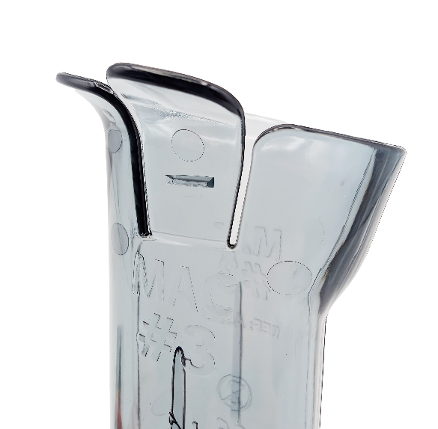
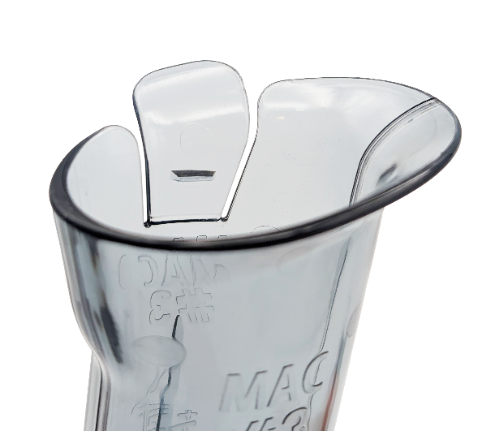
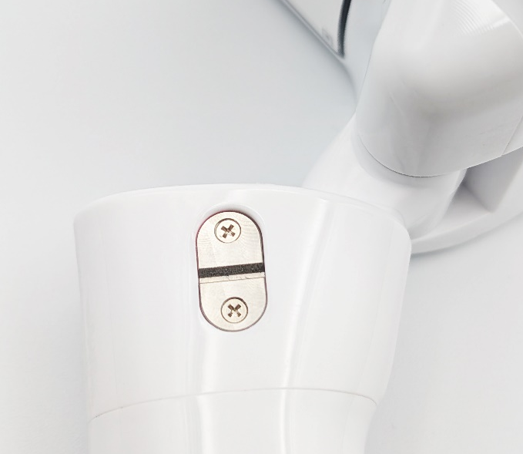
9. Blade Assembly.
Lock mechanism.
Proper position of Video Unit inside the blade is secured by a lock mechanism
It consists of a plastic clip located in the tab of the blade and a metallic slot attached to the video unit
.

Slide 22
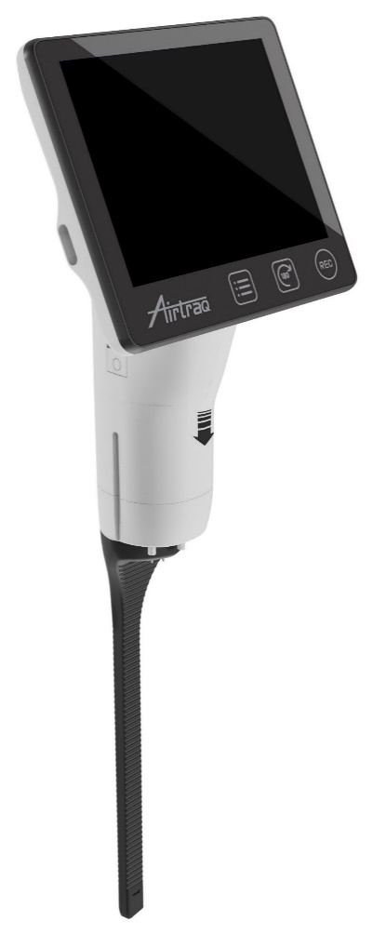
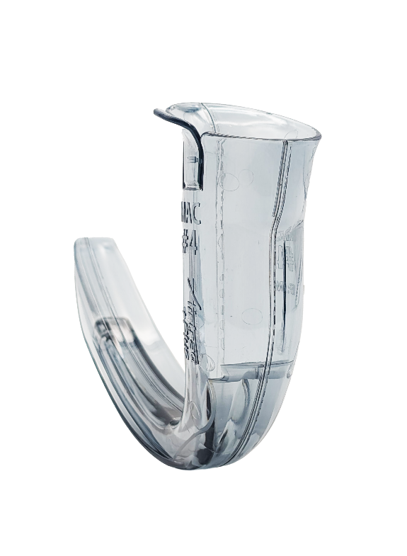
9. Blade Assembly.
Orientation & Insertion.
Orientate Video Unit and blade before starting to assemble.
User shall grip blade pointing to patient.
Video unit shall be handled with “arrow” facing the user.
Video unit must be slid into blade.
.

Slide 23
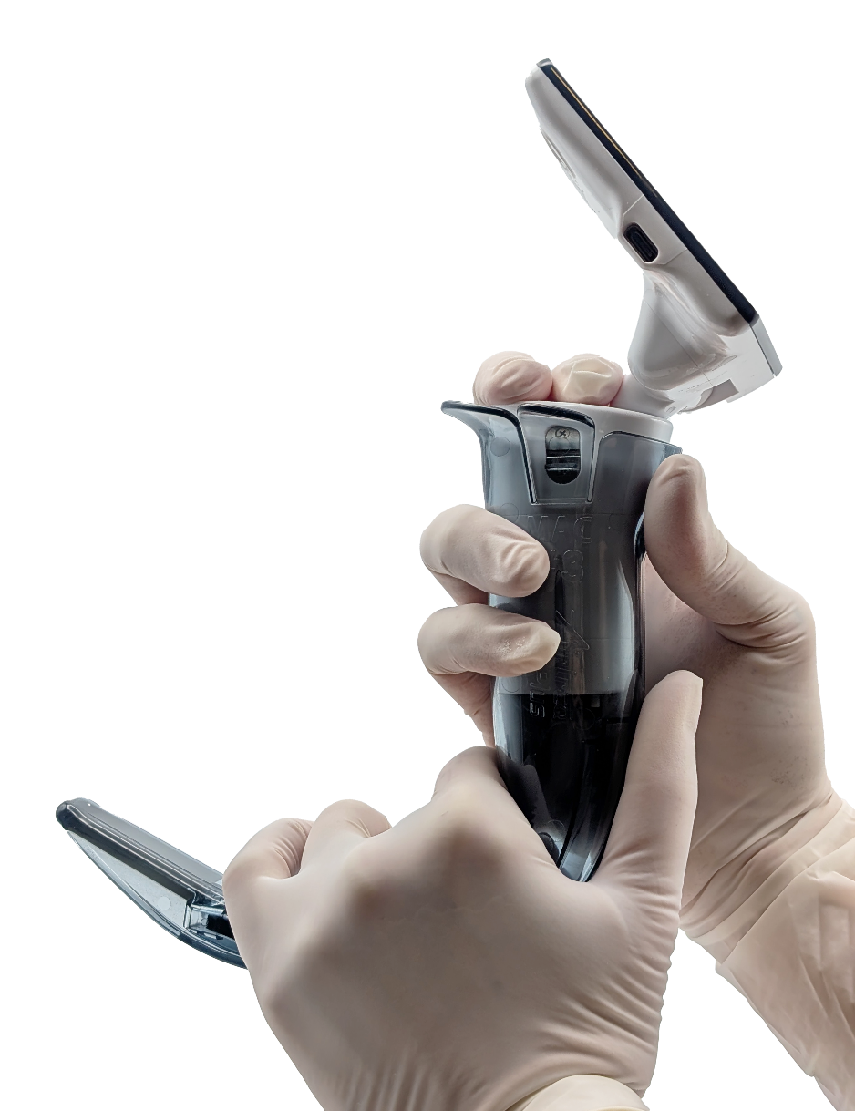
9. Blade Assembly.
Final lock.
Once Video unit is almost fully inserted user shall press down firmly, using two fingers until the lock mechanism closes.
The clip of the blade will hook the metallic slot of the video unit.
A “Click” sound will confirm full insertion.

Slide 24

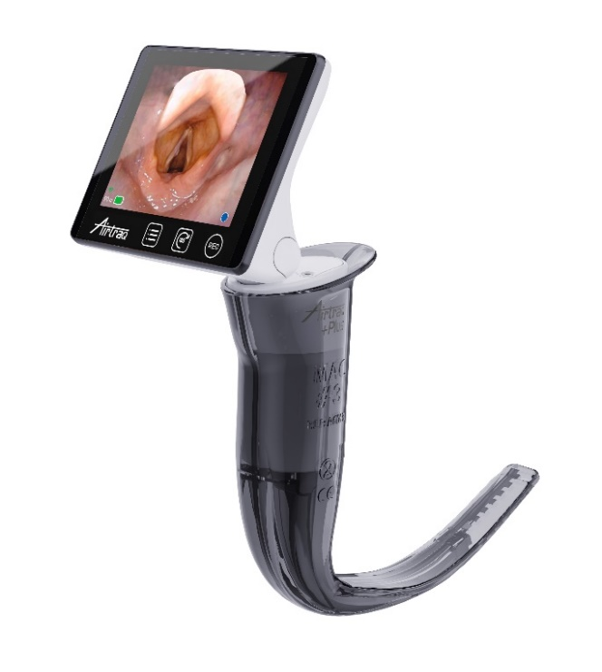

9. Blade Assembly.
Automatic Power On.
3 secs.
Airtraq Plus automatically turns on (in 3 secs) in ‘Live Video’ mode.
It automatically detects which blade has been assembled and adjust zoom, light and image settings.

Slide 25
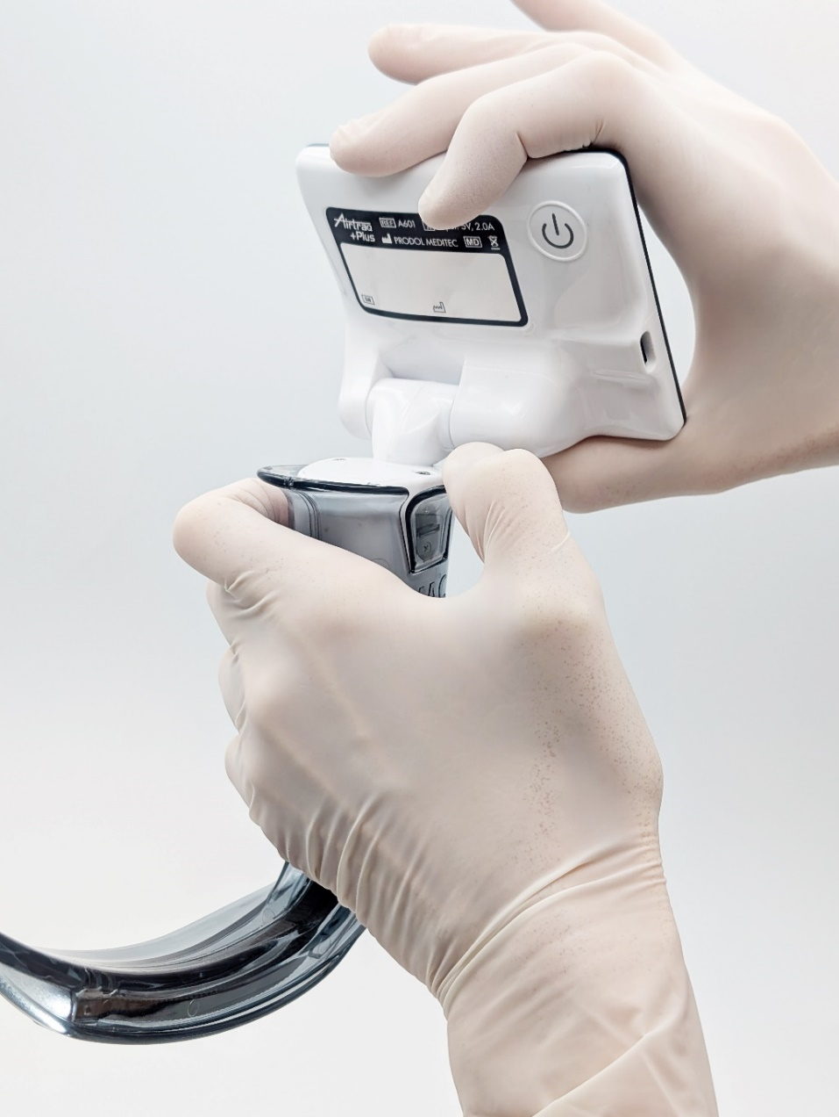
10. Blade Extraction and Disposal
Pull out laterally Lock/Release blade´s tab
Slide Out Blade from Video Unit.
Dispose blade.
Clean Video Unit

Slide 26
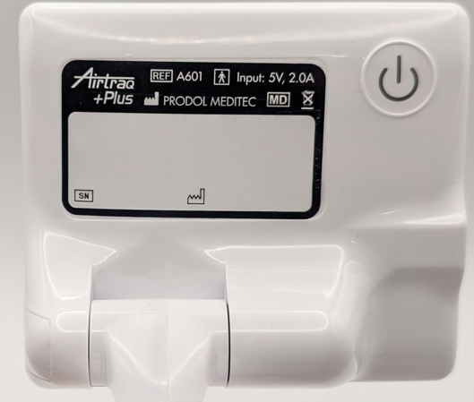
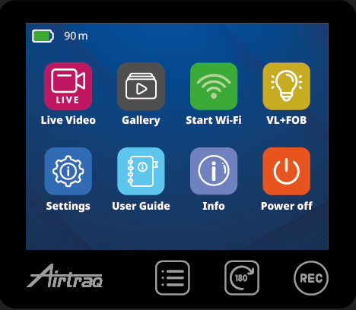
11. Turn on and automatic shut down
  To power on, either:
    Insert blade
    Manually press for 2 seconds Power On Button located on the back of the screen
  To turn off, press Power off icon on main menu.
When blade is not assembled and there is no user action for 5 min, the video unit turns off automatically.

Slide 27
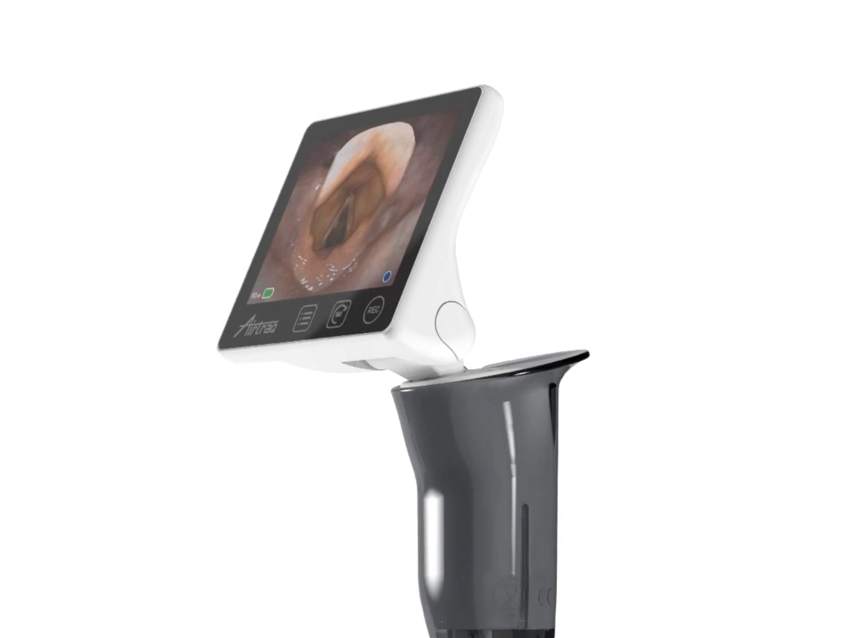
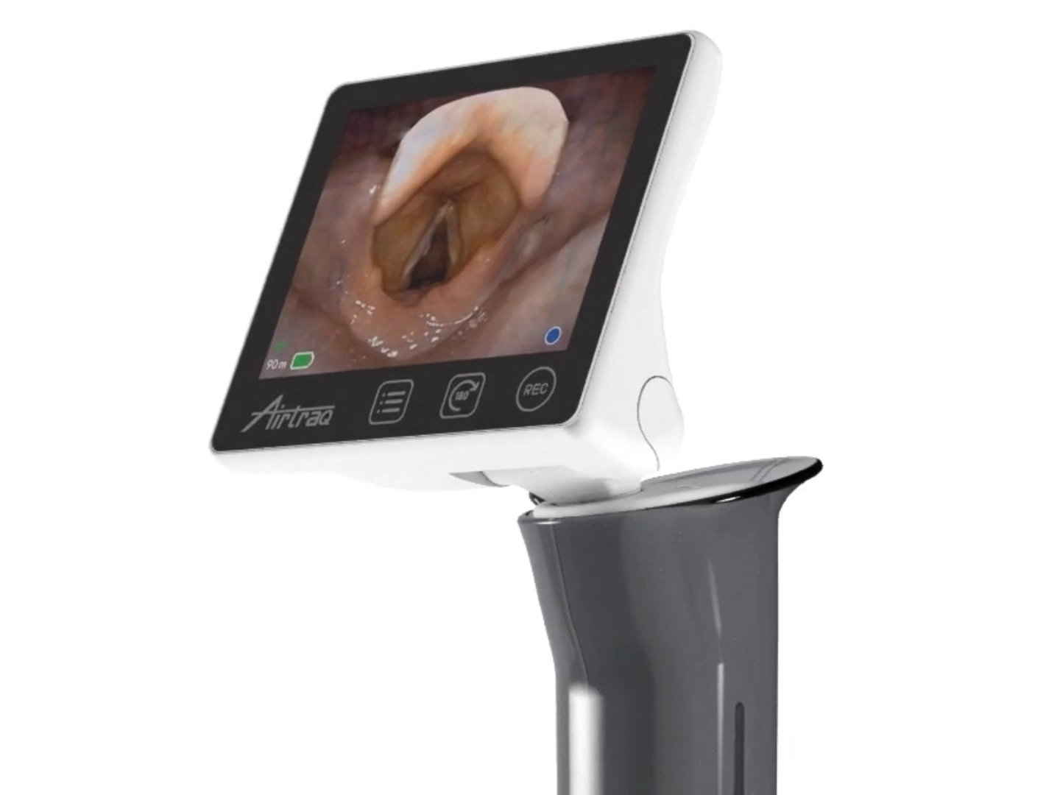
12. Screen flip & swivel 2 Axis .
Allows intubation from any position.
Full swivel & flip 180º reduces device´s height.

Slide 28

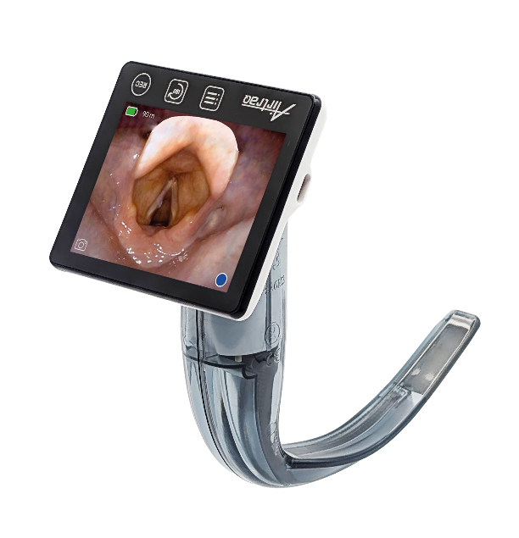

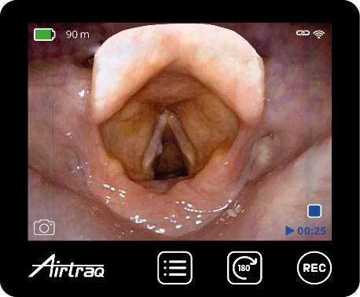
13. Image 180º rotation
Press “Rotate 180º” to maintain correct anatomy orientation when :
  Screen is swiveled and flipped 180º.
  Intubating face-to-face.

Slide 29



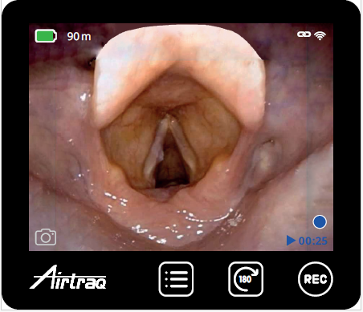
14. Wi-Fi connection. Overview
Activate Wi-Fi in Main Menu
Airtraq Plus creates its own Wi-Fi hotspot. Range approx. : 10 m.
  Only one receiver at a time. When device is connected, WiFi indicator becomes white and a “linked” indicator is displayed.
On start, Wi-Fi activation status remains as it was when last turned off.

Slide 30

15. Wi-Fi connection to Max View
10.4” Max View Display automatically connects with the closest Airtraq Plus unit emitting WiFi signal.
Max View can also be wired to Airtraq Plus through a proprietary HDMI cable (A680).
Check “A-300 Max View Display” Instructions for Use.

Slide 31

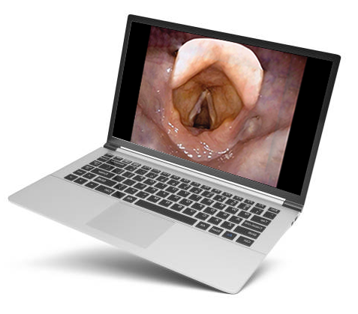
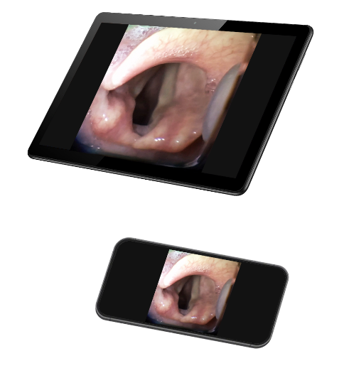
16. Wi-Fi connection to Tablet / Phone / PC
Airtraq Plus can be connected to:
  iOS mobile Devices
  Android mobile devices
  Windows PC
  Mac
  The corresponding App must be installed in the device that will connect to Airtraq Plus.

Slide 32

16. Wi-Fi : Apps on Tablet / Phone / PC
1. ‘Airtraq Cam’ App for:
  iOS (Apple)
  Android
  Free download
2. ‘Airtraq Cam’ App for PC (Windows /Mac) :
  Free download from:
  www.Airtraq.com/downloads/
For further details, please check Instructions for Use or Help of each App.

Slide 33
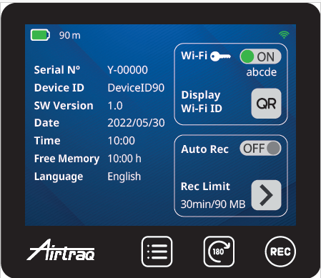
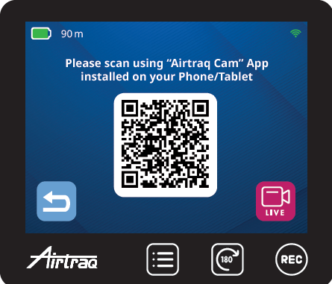
16. Wi-Fi : Tablet/Phone identification on Airtraq Cam App.
Press “QR” Icon
Scan Cam ID
Use Tablet or Phone’s camera to capture the QR code.

Slide 34

16. Optional Wi-Fi password
When a device is connected for the first time to an Airtraq Plus, if password is activated, user will be prompted to input password on the mobile device.
Password is deactivated by default.
Password may be enabled/disabled on Airtraq Plus Settings Screen.
Password may be changed using ‘Airtraq CAM’ app for PC (Settings).

Slide 35
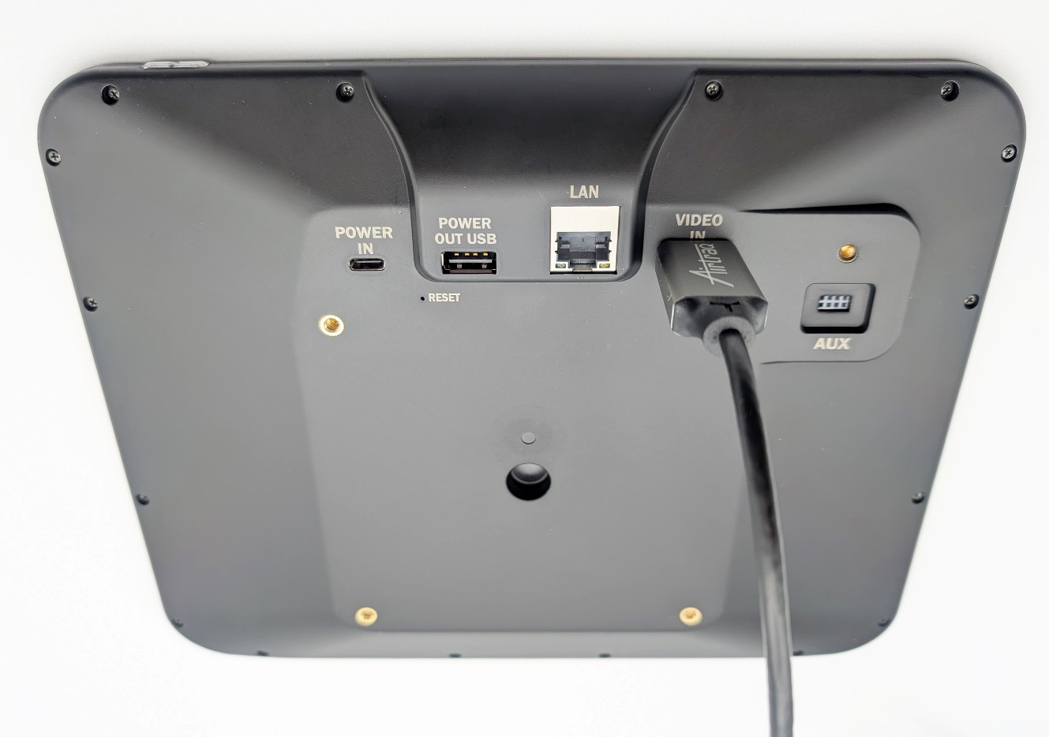
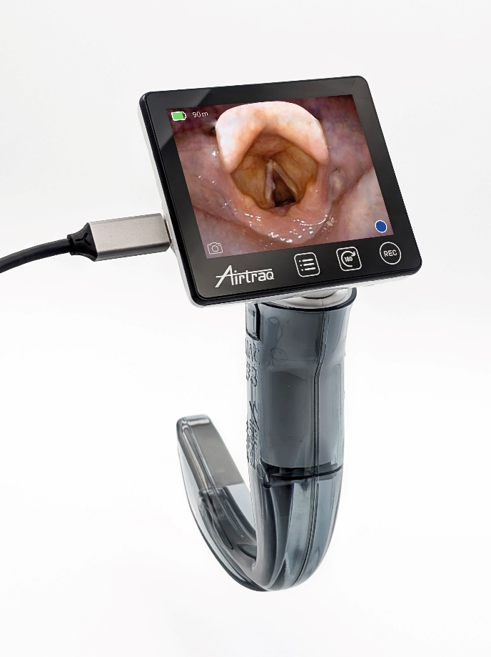
17. HDMI Cable connection
To Max View
10.4” Max View Display can also be connected by cable, if preferred.
Use the proprietary Airtraq Cable USB-C to HDMI provided (A680).

Slide 36
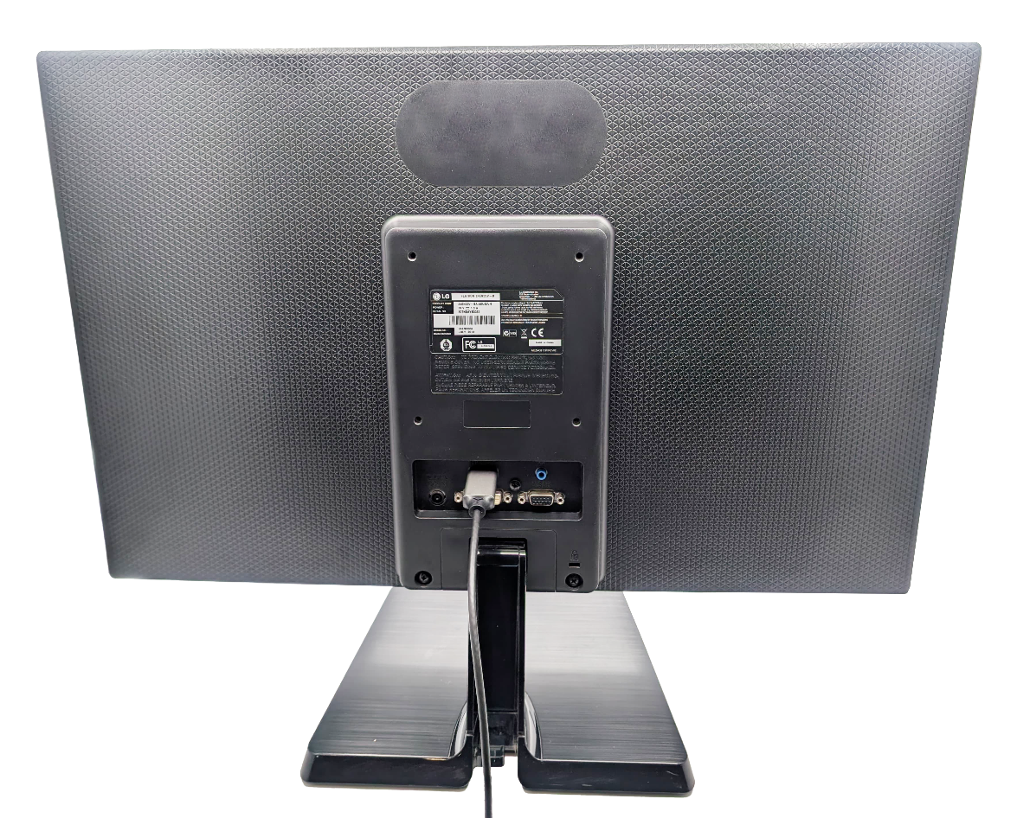
17. HDMI Cable connection
To generic monitor
Airtraq Plus can also be connected by cable to a Generic Monitor with HDMI input.
Use the proprietary Airtraq Plus Cable USB-C to HDMI provided (A680).

Slide 37
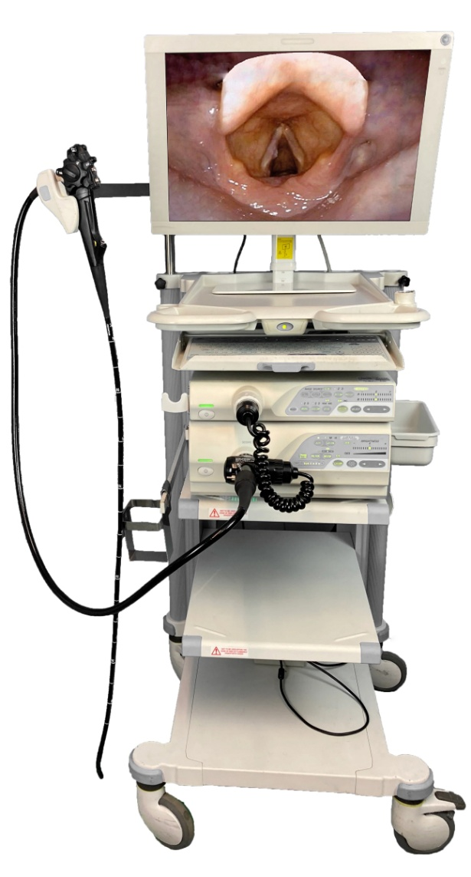
17. HDMI Cable connection
To Endoscopic Monitor
Use the proprietary Airtraq Plus Cable USB-C to HDMI provided (A680).
Airtraq Plus can also be connected by cable to most Endoscopic Monitors with HDMI input.

Slide 38
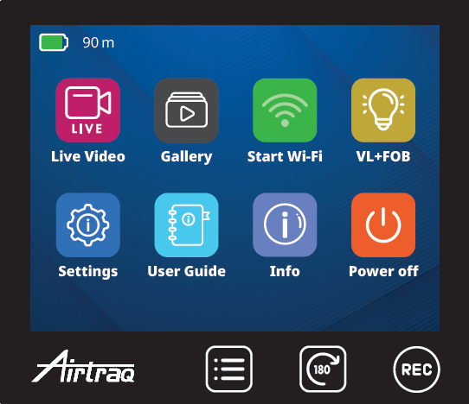
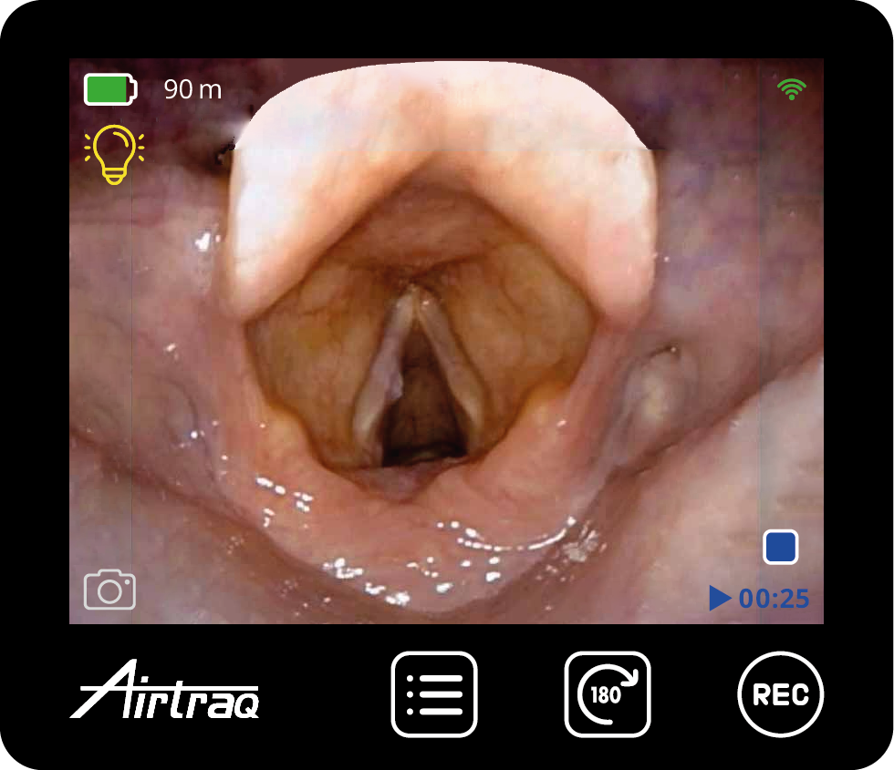
18. VL + FOB
Helps to perform Hybrid intubations:
VL combined with FOB.
This function avoids the excessive glare produced by the simultaneous light of both devices.
The user can manually reduce the light provided by the Airtraq Plus to 20%.

Slide 39
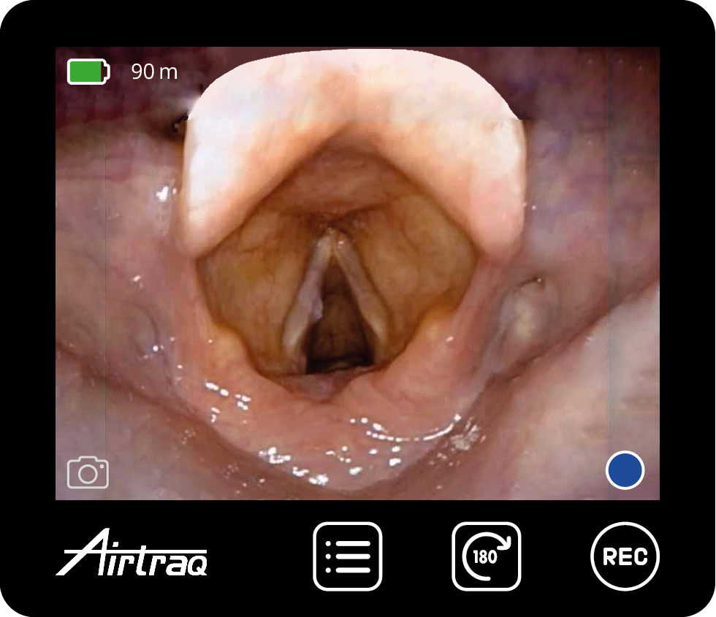
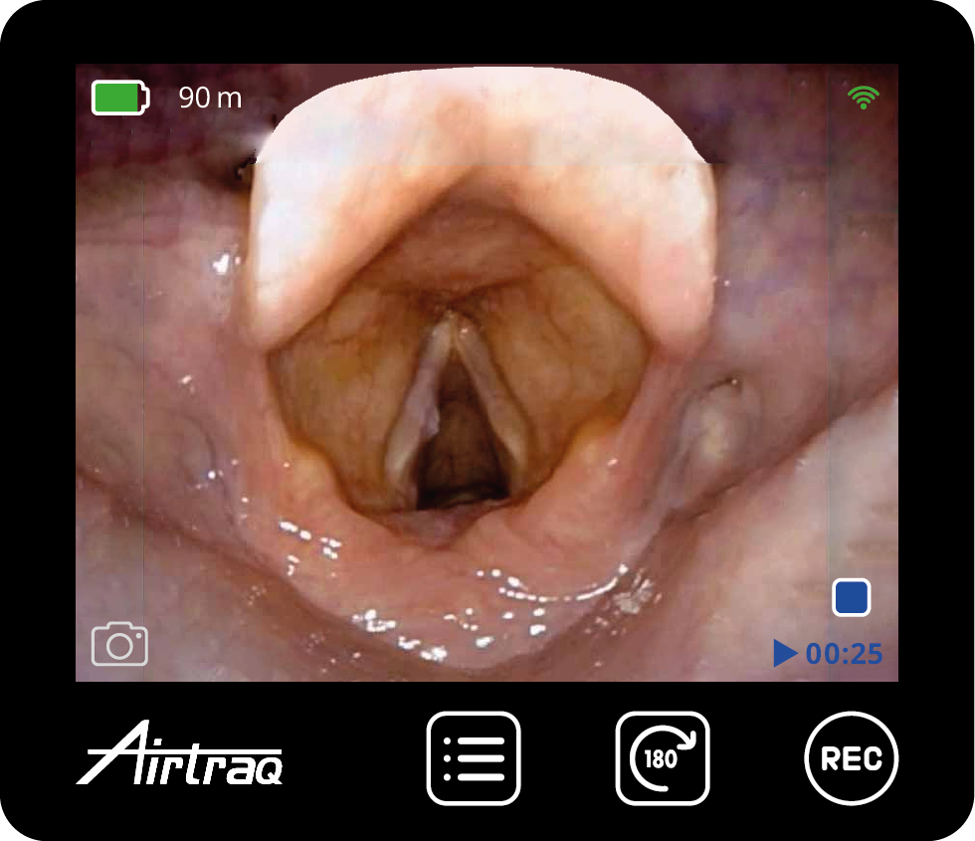
19. Video Recording & Snapshots
To Start and Stop recording press “REC” icon underneath the image area or icon on right lower corner of the image area. A recording indicator and counter is displayed.
Video Storage capacity: Aprox.10 h – Maximum 200 videos. Maximum time for each video is 30 min.
Take a snapshot by pressing icon on left lower corner.

Slide 40
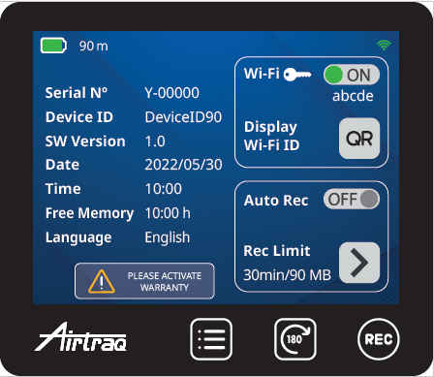
20. Auto-Record
When it is activated, recording starts automatically each time the user enters into Live Video mode. Auto-Rec is deactivated by default.
Activate Auto Recording on Settings screen or using Airtraq Cam App/Settings.
User can define maximum length (min.) and size (MB) of auto recorded videos.

Slide 41
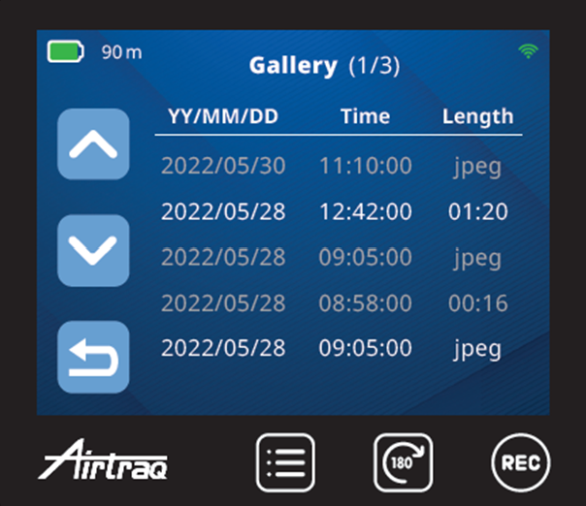
21. Gallery
Videos are listed from newest to oldest.
Press up and Down icons to navigate through the Gallery pages.
Select a video, it will begin to play automatically.
Videos previously viewed are shown in light grey color.

Slide 42
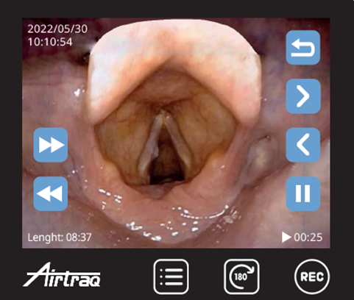
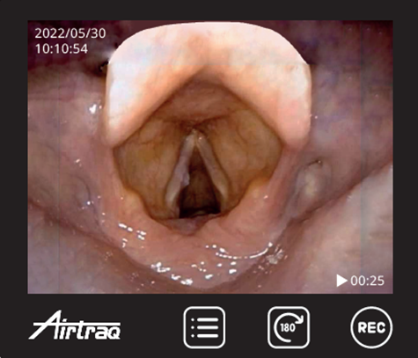
21. Playback
Video / Photo
The user can hide or display all action icons by touching the center of the screen.
Each time fast-forward or fast -rewind icons are pressed video advances or rewinds 10 secs.
Use next or previous icons to playback corresponding videos.
Go back to video gallery to select another video.

Slide 43
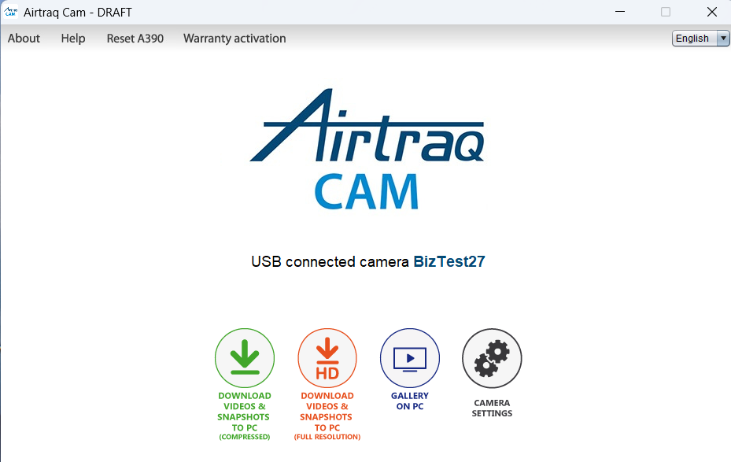
22. Download & Delete videos
Connect Video Unit to PC (A681 cable) and open “Airtraq Cam” App.
Videos can be downloaded in native resolution or compressed.
User can select location of the “Gallery on PC” where Videos are downloaded.
Select individual Videos to be downloaded or download all videos not previously downloaded.
Videos can also be deleted.
For further detail, please check “Airtraq Cam” App Instructions for use or Help.

Slide 44
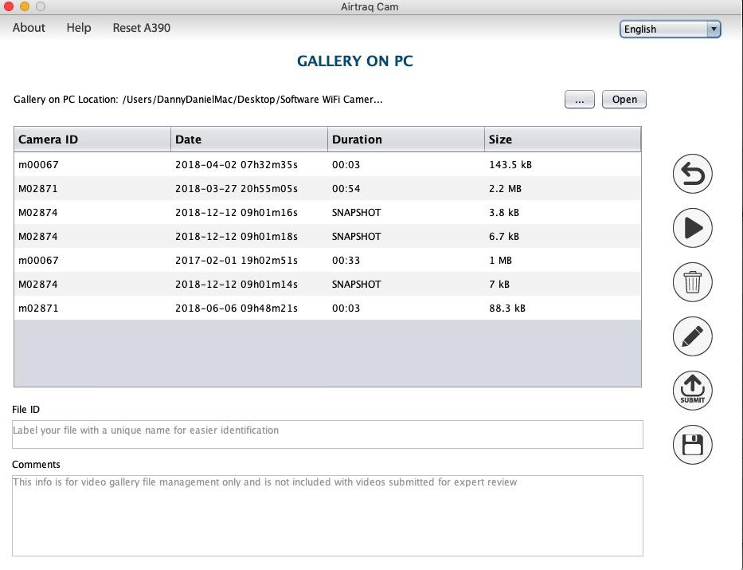

23. View and add notes to video files
Videos downloaded using “Airtraq Cam” App on PC are stored in the App´s “Gallery on PC”.
Videos can be played in “Gallery on PC”.
A unique File ID and comments can be added to each video once it is downloaded to “Gallery on PC”.
Click on to write comments and click
to save.

Slide 45
24. Cleaning and Low Level Disinfection. Cleaning solutions
Wipe down the exterior surfaces of the Video Unit.
Be careful to keep running liquid off the surfaces.
Blot dry the Video Unit using an individual sterile surgical towel.
The following cleaning solutions may be used:
  Enzymatic Cleaning Solutions (e.g.: ENZOLTM Enzymatic Detergent).
  Neutral pH soap and water.
  Sodium bicarbonate solution (8- 10 %).

Slide 46
24. Cleaning and Low Level Disinfection. Disinfection agents.
The following disinfection agents may be used:
  Peracetic Acid Solution (0.08%).
  Isopropyl Alcohol (70%).
  Solution containing 70% Isopropyl Alcohol and 2% chlorhexidine (e.g. Clinell Wipe).
  Solution containing chlorine dioxide (e.g. Tristel Wipe).
  PDI Sani-Cloth® Germicidal Wipes (AF3, Bleach, Plus or Super Sani-Cloth®).

Slide 47

24. Cleaning and Low Level Disinfection. Video Camera
In case any particle sticks to the lens of the video camera the image may become blurry.
Clean the lens of the camera using a micro swab with microfiber tip/wand, humidified with any of the cleaning solutions mentioned above.

Slide 48
24. Cleaning and Low Level Disinfection. Protective case.
Silicone case can be cleaned using the following disinfection agents:
  Isopropyl Alcohol (70%).
  Solution containing 70% Isopropyl Alcohol and 2% chlorhexidine (e.g. Clinell Wipe).
Isopropyl alcohol can cause slight temporary swelling of the silicone, but as long as it is allowed to evaporate completely it will not deteriorate the silicone case.

Slide 49
25. Troubleshooting (1)
Ensure Airtraq Plus battery is properly charged.
Upgrade Software to the latest available. Connect to PC through USB (A681 cable) and open “Airtraq Cam” App. Automatic SW update will start.
If storage is full, connect to PC through USB and use “Airtraq Cam” App to delete videos or snapshots.

Slide 50
25. Troubleshooting (2)
When connecting to a PC through USB (A681 cable), avoid manipulating files directly. Use of “Airtraq Cam” App to upload and manage videos is recommended.
If problems persist perform a “Hard Reset” back to factory settings.
  Connect to PC through USB (A681 cable).
  Open “Airtraq Cam” App.
  Select Reset A600 from the upper bar menu.

Slide 51
26. User Assistance
Please contact your Airtraq Agent
Or contact the manufacturer at www.Airtraq.com
Or send an email to: user.assistance@airtraq.com

Slide 52
27. Important Safety Instructions (1)
Keep, read and follow all of these instructions.
Ensure that A-601 is cleaned and low-level disinfected before and after each use in accordance with above instructions.
The A-601 does not work when it is being charged. It should be charged at least 2 m away from the patient.
Use only the A-601´s battery charger supplied by the manufacturer. Do not charge near any heat source or during lightning storms. Protect the charging cord from being damaged.
To reduce the risk of fire or shock hazard, do not expose this equipment to rain or moisture. Do not place vessels containing liquids on top of the device. Do not splash liquids on top of the device.

Slide 53
27. Important Safety Instructions (2)
Do not use this equipment in presence of flammable anesthetics.
A-601 is portable RF communications equipment. It may cause radio interference or may disrupt the operation of nearby equipment. It may be necessary to take mitigation measures, such as, reorienting or relocating the A-601.
ESD (Electrostatic discharge) may cause malfunction of this device.
Do not attempt to service this device yourself as opening or removing covers may expose you to hazards. Do not open battery box, unless for disposal of the full device. Refer all servicing to qualified service personnel from your Airtraq Agent.

Slide 54
Enjoy your

